Slide 1
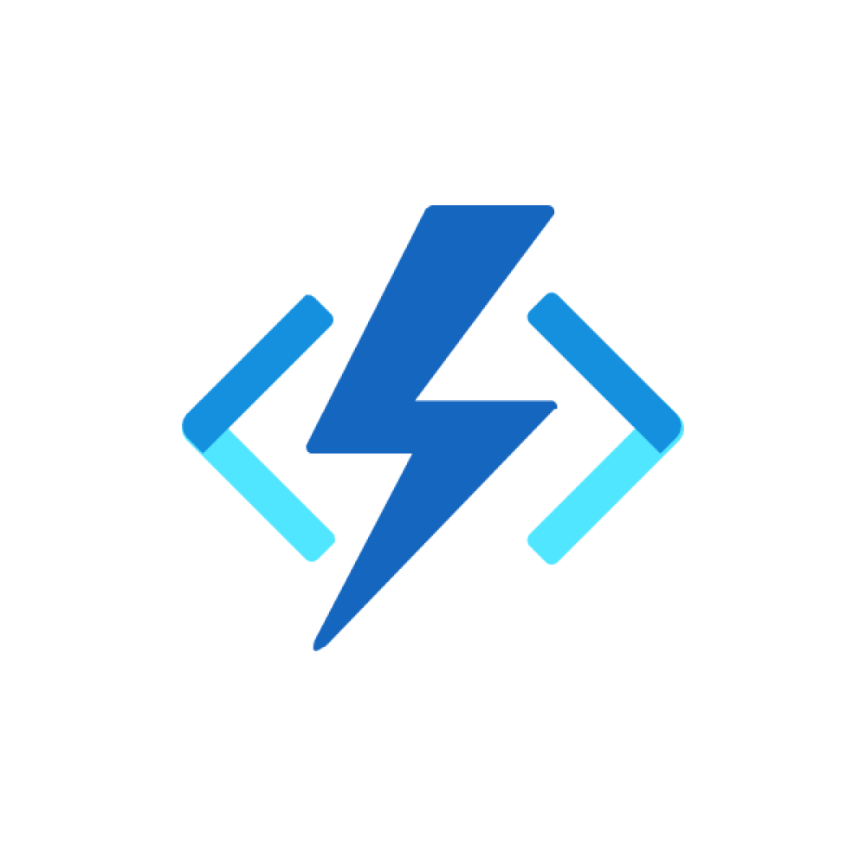
Code reusability in Azure functions

Slide 2
Azure function architecture

Slide 3
Azure Functions in a hybrid environment
This reference architecture illustrates multiple local branches of an organization that's spread out geographically.
Each location is using a Microsoft Azure Function App that's configured with the Premium plan in a nearby cloud region.
The developers in this architecture are monitoring all the Azure Function Apps by using Azure Monitor as a single pane of glass.

Slide 4
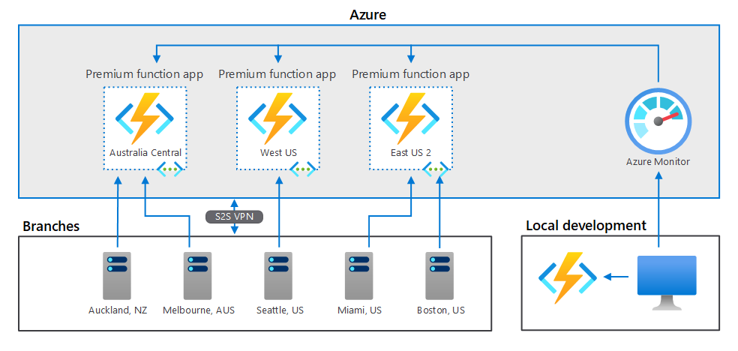
Architecture

Slide 5
Components
Azure Functions.
Azure Functions is a serverless platform as a service (PaaS) in Azure that runs small, single-task code without requiring new infrastructure to be spun up. The Azure Functions Premium plan adds the ability to communicate with Azure Functions privately over a virtual network.
Azure Virtual Network.
Azure virtual networks are private networks built on the Azure cloud platform so that Azure resources can communicate with each other in a secure fashion. Azure virtual networks service endpoints ensure that Azure resources can only communicate over the secure virtual network backbone.

Slide 6
Scenario details
Typical uses for this architecture include:
Organizations with many physical locations that are connected to a virtual network in Azure to communicate with Azure Functions.
High-growth workloads that are using Azure Functions locally and maintaining the option to use Azure for any unexpected bursts in work.

Slide 7
Designing for a serverless architecture
Traditional enterprise applications trend toward a monolithic application architecture in which one code "solution" runs the entire organization's business logic.
With Azure Functions, the best practice is to design for a serverless architecture in which individual functions perform single tasks. These single tasks are designed to run quickly and integrate into larger workflows.

Slide 8
Azure function with other services

Slide 9
DevOps in Azure function

Slide 10
DevOps with Azure Stack Hub
This solution enables you to build, test, and deploy an app that runs on multiple clouds. Code comes from a single location and deploys to multiple targets in development, test, and production environments in your local datacenter, private clouds, or the public cloud.
Differences in environment require a change to a configuration file, rather than changes to the code.

Slide 11
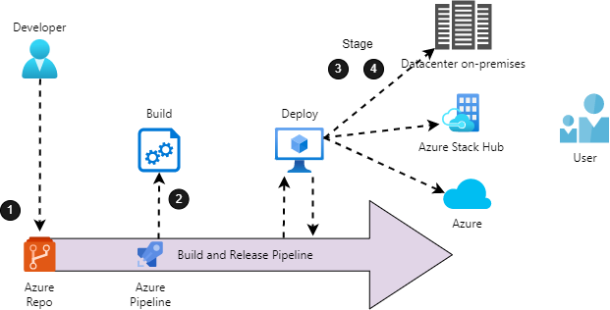
Architecture

Slide 12
Dataflow
Changes to the application code are committed to the git repository in Azure Repos.
The code commit automatically triggers a new build by the build and release pipeline in Azure Pipelines.
The build and release pipeline automatically deploys the newly built code to on-premises, private cloud, and public cloud environments for user acceptance testing.
The code is automatically deployed to on-premises, private cloud, and public cloud production environments, once it has passed testing.

Slide 13
Components
Azure Stack Hub extends Azure services and capabilities to your environment of choice—from the datacenter to edge locations and remote offices. Build, deploy, and run hybrid and edge computing apps consistently across your IT ecosystem, with flexibility for diverse workloads.
Azure Repos is a set of version control tools that you can use to manage your code.
Azure Pipelines automatically builds and tests code projects to make them available to others. Azure Pipelines combines continuous integration (CI) and continuous delivery (CD) to test and build your code and ship it to any target.

Slide 14
Considerations
Reliability
Availability in the context of the DevOps solution means being able to recover any state information that's associated with your workflow, such as test results, code dependencies, or other artifacts. To assess your availability requirements, consider two common metrics:
Recovery Time Objective (RTO) specifies how long you can go without a system.
Recovery Point Objective (RPO) indicates how much data you can afford to lose, if a disruption in service affects the system.

Slide 15
Security
Another major consideration when designing the system used for deployment automation is the access control and the proper management of the rights that are needed to deploy services to cloud environments.
What rights are needed to create, delete, or modify deployments?
For example, one set of rights is typically required to create a resource group in Azure, and another set is required to deploy services in the resource group.

Slide 16
Operational excellence
Automated deployments reduce the chance of human error.
Fast and routine deployment processes won't slow down the release of new features or bug fixes.
The design of any system that's based on the DevOps solution idea must consider automation, logging, and alerting for each service across the portfolio.

Slide 17
Performance efficiency
Deployment automation systems are the key control point in a DevOps solution.
Implementations can vary. The selection of the correct server size depends on the size of the expected workload. VMs cost more to scale than containers.
To use containers for scaling, however, your build process must run with containers.

Slide 18


